Slide 2
SUMMARY
This Article dives into innovation in emerging markets and riveting exploration of recent events that have reshaped the trajectory of Vision 2030, leaving an indelible mark on pivotal projects like Konza Technopolis. This article transcends the ordinary, delving into the proposed capabilities of Konza and assessing Kenya's current state, questioning whether Konza can generate more than Kenya can absorb. It Unveils the untapped potential lies the essence of this narrative, emphasizing the paramount role of data analysis, and data acquisition to drive data driven decisions for achieving equitable growth. Amidst the pages, the importance of data transcends mere documentation; it emerges as the catalyst for Konza's viability. Brace yourself for an illuminating journey that unfolds the dynamic interplay of events, proving that data is the linchpin to realizing Konza's full potential and ushering in an era of balanced growth. This is not just a story; it's a call to unravel the untold possibilities that lie at the nexus of Vision 2030 and Konza Technopolis.

Slide 3
INTRODUCTION
Do you Actual know in 1968 that Singapore came to Nairobi to benchmark how to develop a better city and it is not documented anywhere on the internet? They actually gained ideas so good and put them into use that it led to Singapore a few years to gaining GDP higher that of Kenya and 55 years later to become the 3rd smartest city in the whole world. In 1963, when Kenya got independence, and Singapore merged with Malaysia, Kenya’s GDP was $926.6 million while Singapore’s was $917.2 million. In 1978, when the founding president of Kenya died, Kenya’s GDP had grown to $5.3 billion, but had been surpassed by Singapore whose GDP then had grown to $8.06 billion. By 1990, when Kuan Yew stepped down from PM’s office (and Kenya on the verge of multiparty democracy), Singapore’s GDP was $38.9 billion compared to Kenya’s $8.57 billion. Recent figures are more embarrassing. By 2013, as Mr Kenyatta was taking over the reins of Kenya’s leadership, he was managing an economy of only $55.24 billion while his

Slide 4
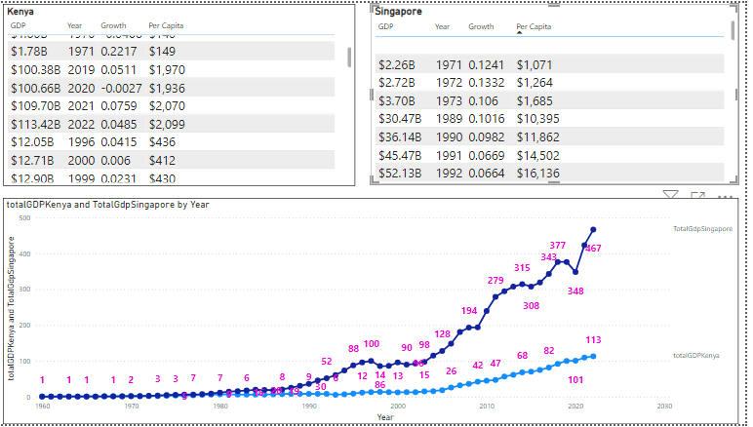

Slide 5
counterpart Mr Hsien was managing a whopping $297.9 billion economy. The biggest Question is what happened to Kenya? My million-dollar question is what did we get wrong that Singapore Got right? And if we do not get it right “sweat the Details” for Konza Technopolis, we might want to build other several Technopolis. What has made Singapore to be what it is? Here it is: Smart City 6.0. The concept of Smart Cities strategy has been evolving over the past few decades, from a focus on technology and infrastructure to a more people-centric approach that emphasizes quality of life and sustainability. The latest iteration, Smart City 6.0, takes this approach even further, with a focus on data-driven decision-making and citizen engagement. In this article, we will explore the key characteristics of Smart City 6.0 and why they are important for the average person.

Slide 6
Smart City Strategy 6.0
Smart City Strategy 6.0 is characterized by six key elements: Citizen-centricity, Data-driven decision-making, Sustainability, Innovation and entrepreneurship, Collaboration and Resilience
Citizen-centricity is perhaps the most important characteristic of Smart City 6.0. This means that cities are designed with the needs and preferences of citizens in mind, rather than simply focusing on infrastructure and technology. For example, Smart City 6.0 might include initiatives to make public transportation more accessible and convenient or to create more public spaces for people to gather and socialize.
Data-driven decision-making is another key characteristic of Smart City 6.0. This means that cities use data and analytics to inform policy decisions and improve city services. For example, a Smart City might use sensors and data analysis to optimize traffic flow and reduce congestion or to monitor air quality and take action to reduce pollution.

Slide 7
Sustainability is also a key characteristic of Smart City 6.0. This means that cities prioritize environmentally-friendly practices and policies, such as renewable energy, green spaces, and sustainable transportation options. For example, a Smart City might incorporate solar panels into its public infrastructure, or create more bike lanes and pedestrian-friendly spaces to reduce reliance on cars.
Innovation and entrepreneurship are important components of Smart City 6.0 as well. This means that cities encourage and support start-ups and innovative ideas that can help solve urban challenges and improve quality of life. For example, a Smart City might have a start-up accelerator program that focuses on urban sustainability and social innovation.

Slide 8
Collaboration is another key element of Smart City 6.0. This means that cities work with citizens, businesses, and other stakeholders to co-create solutions and make decisions together. For example, a Smart City might hold public forums and consultations to gather input on new initiatives, or partner with local businesses to implement sustainable practices.
Finally, resilience is a critical characteristic of Smart City Strategy 6.0. This means that cities are able to adapt to and recover from unexpected events and crises, such as natural disasters or social upheavals. For example, a Smart City might have an emergency response plan in place that uses data and analytics to identify areas of need and allocate resources effectively

Slide 9
Are we past vision 2030?
“Now this is scary, apparently the world might have ended in 2012”, you remember in the year 2020 when people thought we were actually in the year 2012 because of switch from Julian calendar to the Gregorian calendar of 1752, and the believe that the world was going to end in 2012 or 2020 could also be true. What if they were right? I don’t know about you. But years have been passing by faster than ever and everyone has been so negative and let’s not forget the events of 2020 the global pandemic that led to the deaths of millions, the close down of businesses, the economic crisis and stay home orders? and now we are living under Russian Ukraine war effects, the war in Israel and Gaza and nations aligning behind each other, the climatic indicators are becoming worse and worse, we are killing each other day by day. What if the world as we knew it did end and we didn’t notice!? Theories suggest that we are currently living in a different reality and some actually believe that the world ended in our perceived 2012 and others believe that it ended with Julian calendar. But from the recent events we agree that there has been a paradigm shift that has altered reality as we know it.

Slide 10
In the wake of these unsettling reflections, it becomes imperative for us to acknowledge that our present reality extends beyond the scope envisioned by Vision 2030 and has surpassed it by a margin of 10 to 20 years. The urgency to harvest extensive data, intensify research efforts, and leverage the capabilities of Konza Technopolis becomes more apparent than ever. The original intent behind the Technopolis’s design is not only achievable but may also be surpassed given the paradigm shift evident in current global happenings.
As we grapple with the challenges of our time, it is essential to recognize that the trajectory of our world has deviated significantly from the predicted course. The notion that the world might have come to an end in 2012 or 2020, fuelled by calendar transitions and apocalyptic predictions, may not be as far-fetched as it once seemed. The acceleration of time, coupled with a barrage of unprecedented events such as the global pandemic, geopolitical conflicts, and climatic upheavals, prompts us to question if we are living in a reality altered by a paradigm shift.

Slide 11
In this new narrative, it is crucial to shift our focus towards proactive data collection, extensive research endeavors, and tapping into the full potential of Konza Technopolis. Only by embracing this altered reality and adapting to its nuances can we navigate the complexities of the present and chart a course towards a more informed and resilient future.
I went through the financial report for Konza Technopolis payment that went to Finance and Business specialists, lawyer, architect and engineers and ICT specialists, it’s a good step but; well, it’s evident from Sir W. Arthur Lewis this time we have gone for services before manufucturing. I Suggest that we need to Add data analyst on that list.

Slide 12
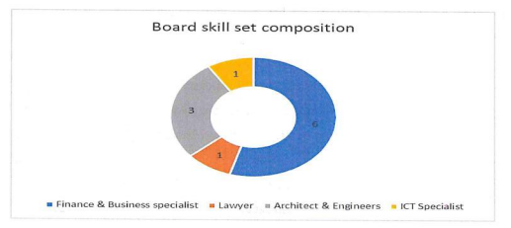
Konza Payment report

Slide 13
In my extensive research, it is apparent that countries with significant investments in information acquisition, data analysis, and intelligence gathering have shown remarkable advancements. The United States serves as a notable example, where substantial financial allocations are made towards IT spending, defense intelligence, and research and development. For instance, the U.S. government's total IT spending reached an estimated $112.2 billion in 2023, encompassing hardware, software, services, and personnel. A significant portion of the U.S. intelligence community's annual budget, around $85 billion, is dedicated to data analysis, technology, and personnel, emphasizing the strategic importance of information acquisition.
Moreover, the robust investment of $46.7 billion in 2023 by the National Institutes of Health for research, with a focus on data analysis and information gathering, highlights the pivotal role played by comprehensive intelligence strategies in driving technological advancements and societal progress.

Slide 14
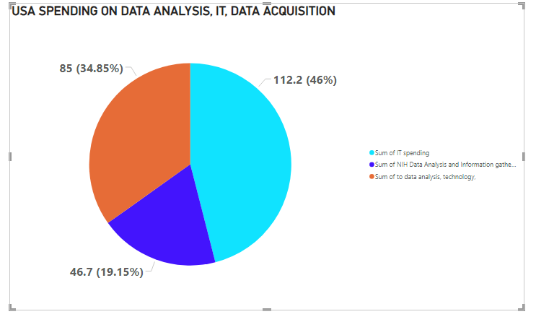

Slide 15
How can Konza's capacity to generate surpassing levels of output be effectively managed considering the absorption limitations within Kenya?
There is documentary and interview between CEO of Black Rock, Blackstone, Santander, Goldman Sachs and Bridgewater. They are all combine probably $ 20 trillion of assets under management and they all did a round table called the Board Room and they all talked about where they think it is going to work in the next five years. Basically, where they see the world going, what are they going to do? They are going to invest their trillion of dollars where they see the world headed to. They were all talking about resetting, resetting of what? Obviously, these people who are understanding that there has been a paradigm shift and the world order is not as it used to be. And how will they know where the world is going? DATA!

Slide 16
Consider the everyday experience of internet users, where a search on Google can seamlessly lead to personalized advertisements on platforms like YouTube. Suppose you are searching a problem in Google the next time you are searching a particular video on YouTube it will start on an advertisement of a product that you can use to solve a problem you had some time back. This personalized advertising demonstrates the power of data analytics in predicting and catering to individual needs. The other Day I watched a video from a certain hacker, in his revelation about a vacuum cleaner that was programmed to send information back to the manufacturers, proofs to what extend developing countries want data.
Drawing attention to the futuristic ambitions of companies like McDonald's, attempting to advertise to people even while they sleep, prompts us to question the origin of such technological ideas. It raises the intriguing inquiry of whether McDonald's is innovating independently or emulating practices from elsewhere. Given the rapid pace of technological advancements, it becomes imperative to investigate if other companies have previously implemented similar advertising techniques.

Slide 17
Relating this global perspective to the local context, institutions like Konza Science and Technology University in Kenya can play a pivotal role. Beyond focusing solely on technology and IT, Konza should extend its emphasis to include robust data legal mechanisms. While Kenya may be perceived as trailing behind, the feasibility of embracing and adapting to this transformative era is undeniably achievable. The key lies in prioritizing relevance and readability in educational programs and research initiatives.

Slide 18
Kenya is able to archivable this level of growth acquire data that we can use to develop this country because Kenya's internet penetration rate has undergone significant growth since 2010, with mobile leading the charge. Here's a breakdown:
Overall Internet Penetration:
2010: Low single digits (~1%)
2023: Around 32.7% (World Bank data)
Mobile Internet Penetration:
2013: Less than 1%
2023: Nearly 32% (Statista)
Computing power:
Moore's Law: Processor performance roughly doubles every two years. This exponential growth implies significant advancements in computing power over 14 years. Global supercomputing power: 8 petaflops in 2010 to 235 exaflops in 2023 (+29,375%) - showcasing massive leaps in computational capabilities for scientific research, AI, etc.

Slide 19
CONCLUSION It is doable to achieve the envisioned goals of Konza Technopolis, and even surpass them but it is within our grasp. The key lies in a strategic shift from prioritizing services before manufacturing and on how much we will sweat on details, echoing the wisdom of Sir W. Arthur Lewis. I emphasize the essence of a people-centered city and critical need for the widespread availability of information. As the first world countries pivots toward an era dominated by data acquisition, there’s danger for us being left behind because this are countries we send our exports to, therefore i cautions against a potential future where our role as suppliers might diminish if we do not keep pace with the global shift towards data-centric economies.

Slide 20
Let the development of technology, IT, and ICT not just be as a technological pursuit but as an imperative for staying informed and relevant on the global stage. I resonate with a call to arms, urging a collective commitment to shaping a future where Kenya not only adapts to the evolving global landscape but leads the charge in leveraging data to build a resilient and prosperous nation.

